Slide 1
Football Player Market Value Prediction
Presented by: sujay
Last updated: May 24, 2026

Slide 2
Problem statement
Football clubs invest millions in player transfers and scouting
Traditional valuation methods rely heavily on subjective judgment
Goal: Build a machine learning model to estimate fair player value using player attributes which provides a Data-driven support for scouting and transfer negotiations

Slide 3
Data cleaning and eda
Checked for missing values, special characters, blanks etc
Columns like league name, club name had 0.1% missing values and replaced these with Not Specified category
Feature Engineering on player positions is done to make them standard positions ie. Converting CF, ST to Forward
FIFA 2023 data comprising of more than 17k players data is taken

Slide 4
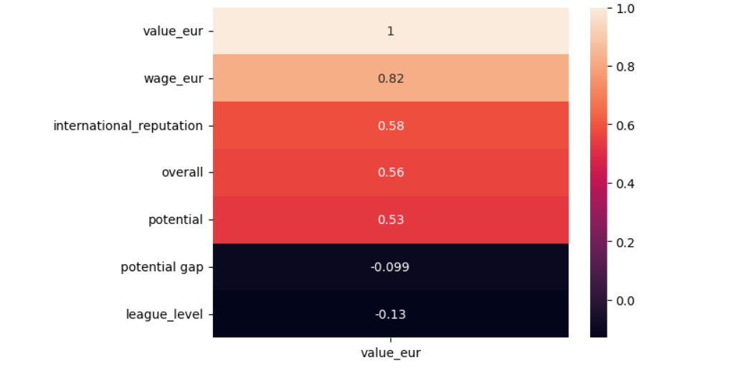
Important variables vs target

Slide 5
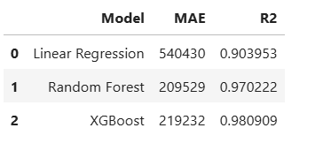
Models used
Multiple Linear Regression has been used as a baseline model
Random Forest and XGBoost are used as improvements to the base line models

Slide 6
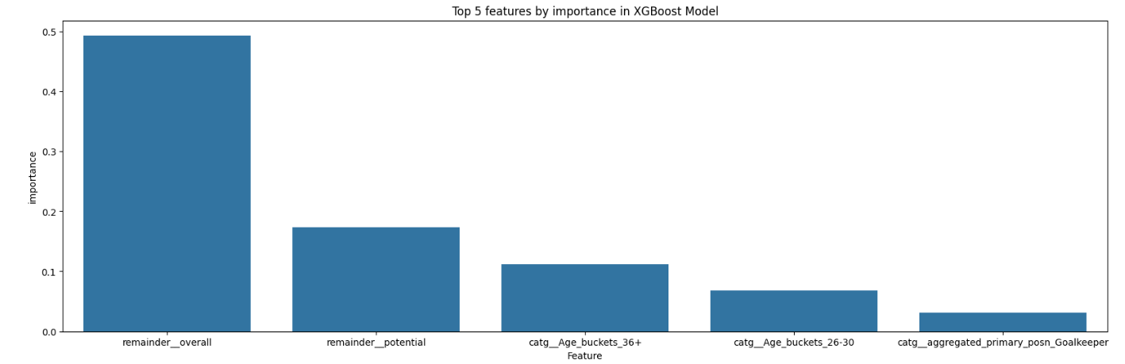
Feature Importance & Insights
Overall Rating contributed nearly 49% of model importance
Potential Rating contributed around 17% importance

Slide 7
conclusion
Successfully developed a machine learning driven player valuation system
XGBoost and Random Forest significantly outperformed baseline regression
Project demonstrated end-to-end ML workflow including EDA, feature engineering and model comparison

Slide 8
Thank you

